Slide 1
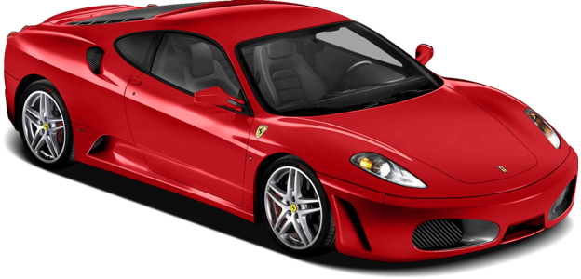
Traffic Flow: Density Dependent Model
Malena Fassnacht

Slide 2
Overview
Model of single-lane traffic flow dependent on density of traffic
Idea:
Driver will be more alert (and therefore react more quickly) if the density of traffic is higher.
Test cases:
Starting from rest
Sudden Stop
Slow Lead Vehicle
Lead Vehicle With Random Velocity
Notes:
Explain test cases later

Slide 3
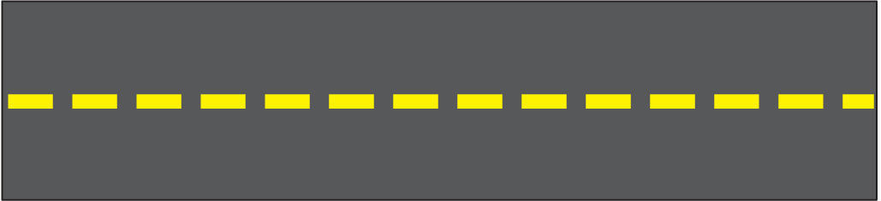
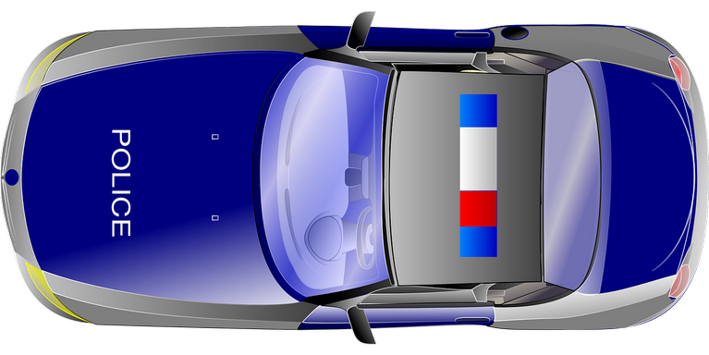
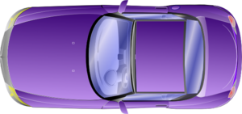
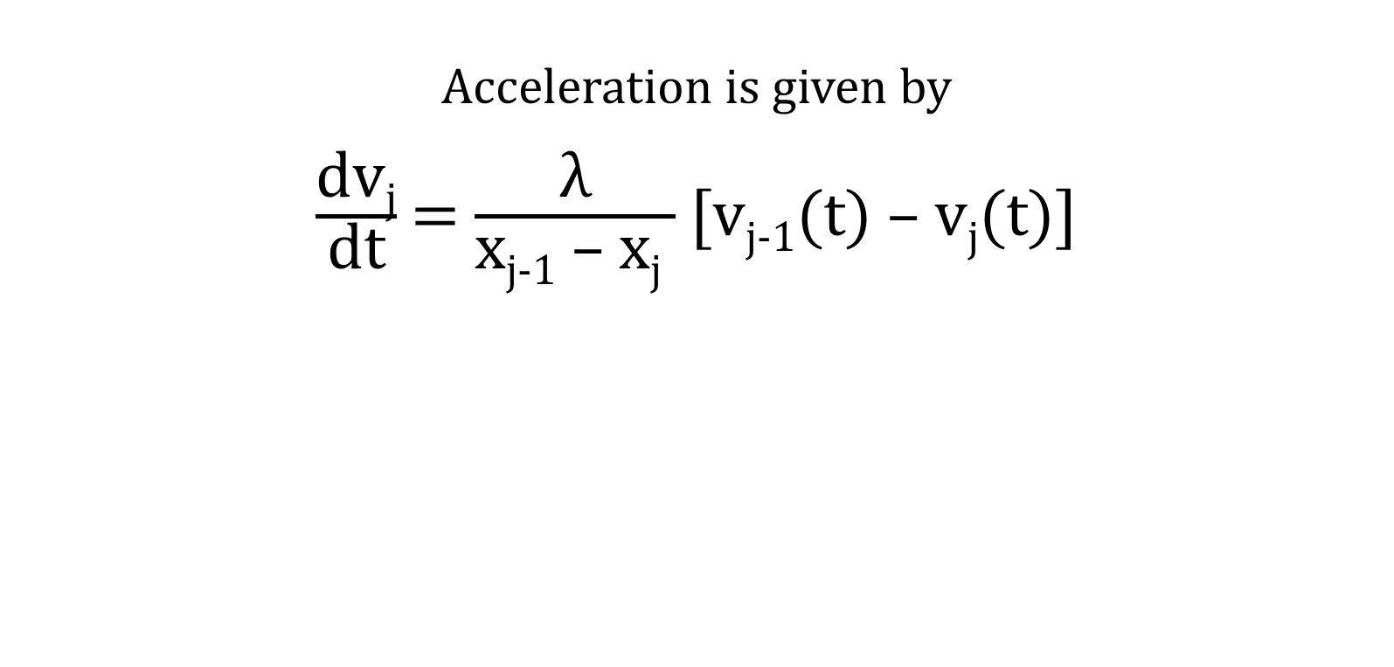
Mathematics
Acceleration is given by
$\frac{\text{dv}\text{j}}{\text{dt}}$ = $\frac{\text{λ}}{\text{x}\text{j}\text{−1 – }\text{xj} }$ [v_{j-1}(t) – v_{j}(t)]
Car [j]
Car [j-1]

Slide 4
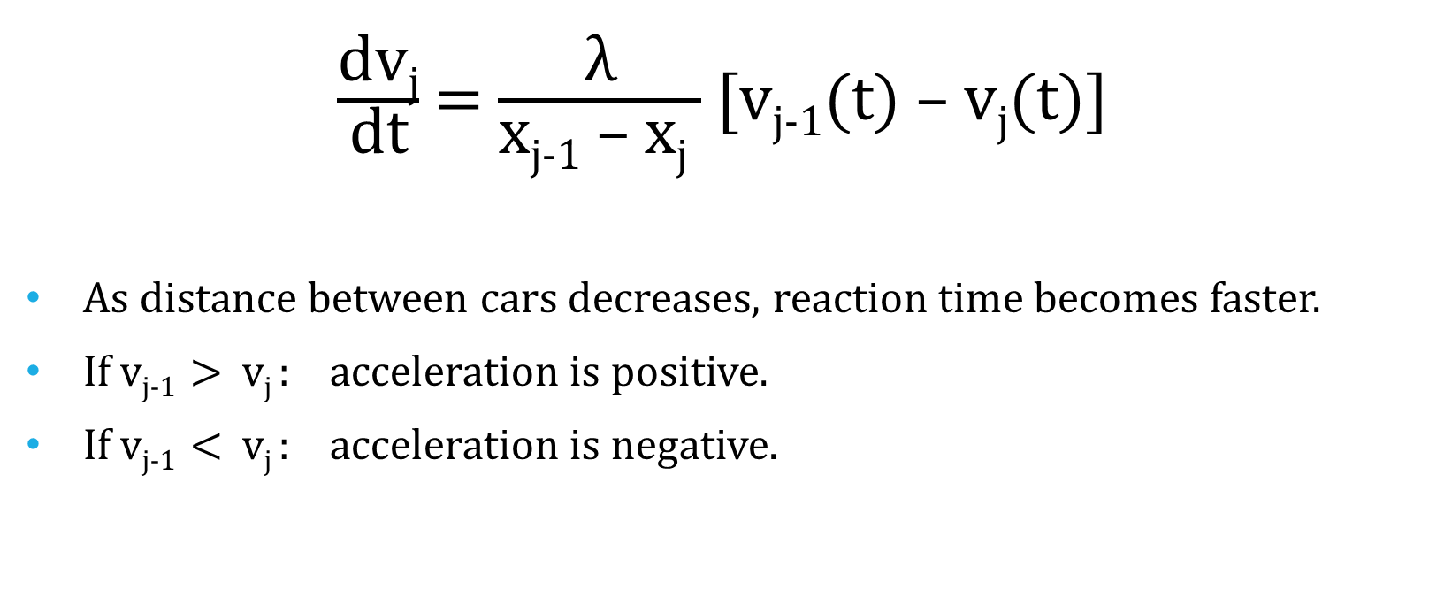
Mathematics
$\frac{\text{dv}\text{j}}{\text{dt}}$ = $\frac{\text{λ}}{\text{x}\text{j}\text{−1 – }\text{xj} }$ [v_{j-1}(t) – v_{j}(t)]
As distance between cars decreases, reaction time becomes faster.
If v_{j-1} > v_{j} : acceleration is positive.
If v_{j-1} < v_{j} : acceleration is negative.

Slide 5
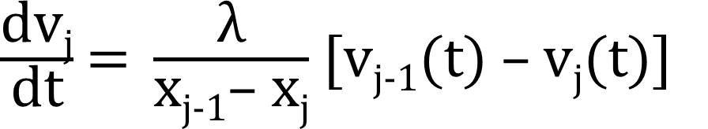
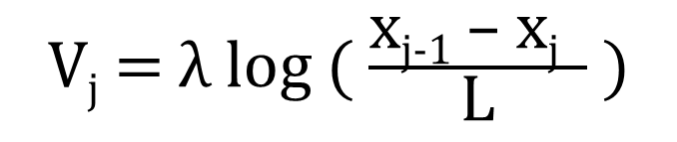

Exact Solution
Can be integrated as
$\frac{\text{dv}\text{j}}{\text{dt}}$= λ $\frac{\text{d}}{\text{dt}}$ log(x_{j-1} – x_{j})
V_{j} = λ log ($\frac{\text{x}\text{j}\text{−1 – }\text{xj} }{\text{L}}$ )
*When L = x_{j-1} – x_{j},
velocity = 0.

Slide 6
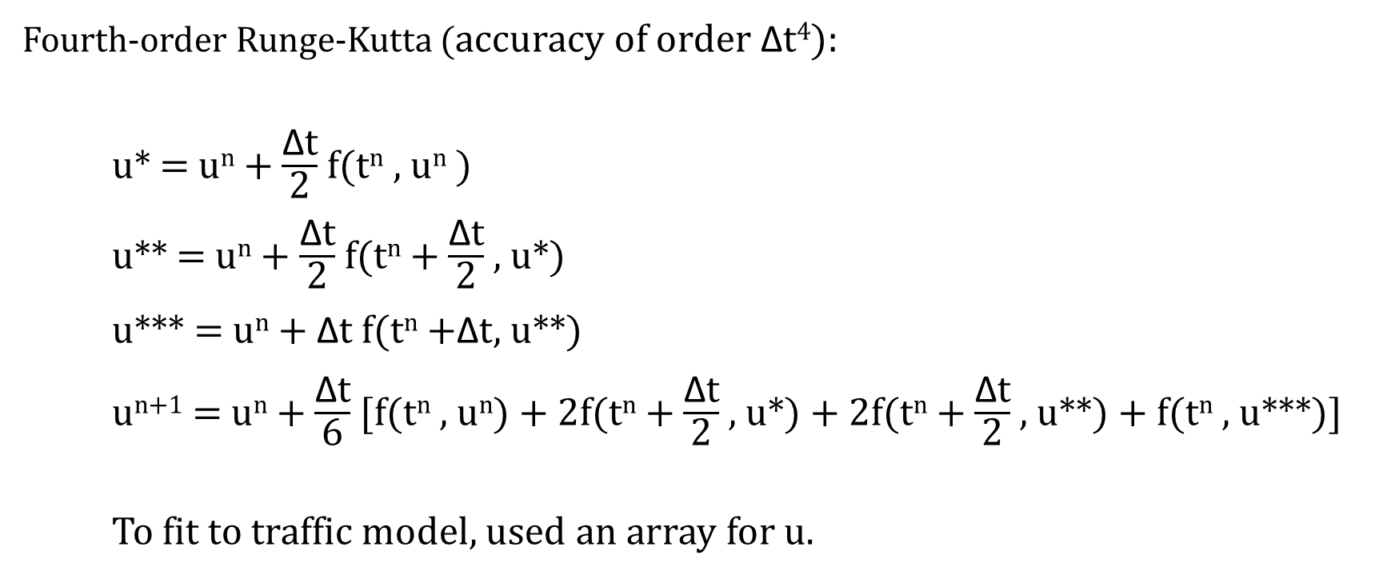
Numerical Method
Fourth-order Runge-Kutta (accuracy of order $\text{Δ}\text{t}$⁴):
u* = u^{n} + $\frac{\text{Δ}\text{t}}{\text{2}}$ f(t^{n} , u^{n} )
u** = u^{n} + $\frac{\text{Δ}\text{t}}{\text{2}}$ f(t^{n} + $\frac{\text{Δ}\text{t}}{\text{2}}$ , u*)
u*** = u^{n} + Δt f(t^{n} +Δt, u**)
u^{n+1} = u^{n} + $\frac{\text{Δ}\text{t}}{\text{6}}$ [f(t^{n} , u^{n}) + 2f(t^{n} + $\frac{\text{Δ}\text{t}}{\text{2}}$ , u*) + 2f(t^{n} + $\frac{\text{Δ}\text{t}}{\text{2}}$ , u**) + f(t^{n} , u***)]
To fit to traffic model, used an array for u.
Notes:
Runge-Kutta very good for this model because it has fourth-order accuracy. For my case, I used it twice to get values for both velocity and position.

Slide 7
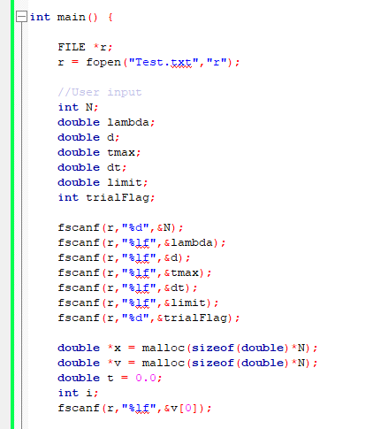
My Code

Slide 8
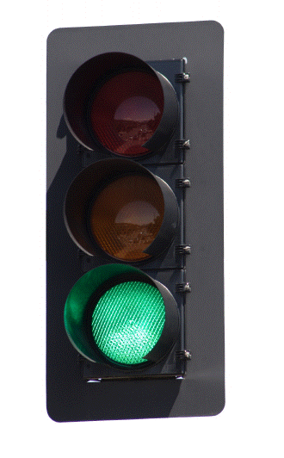

Test Case 1: Start From Rest

Slide 9
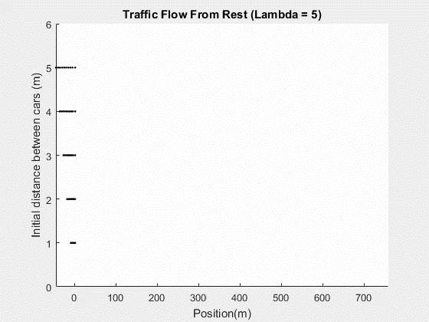
Trial 1
Leading car is given an initial velocity, and all others start from rest.
λ = 5
dt = .1
v[0] = 15 m/s
(~33.5 mph)
Notes:
First case: gave initial velocity to first vehicle, all others stopped. Explain diff. parameters chosen, what goes on in video (different distances).

Slide 10
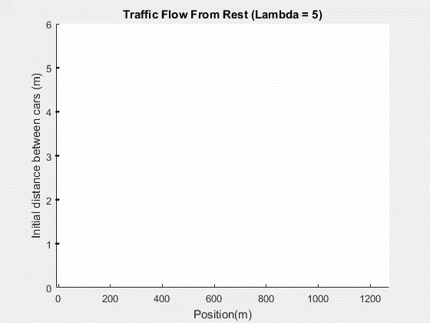
Trial 2: Added Acceleration
All cars start from rest, but the leading car is given an initial acceleration.
λ = 5
dt = .1
Acceleration:
v[0] = t*2.0 (2 m/s²)
Speed limit = 30 m/s
(~67 mph)
Notes:
Wanted a more realistic model, so I added acceleration to first vehicle. Had to create speed limit. Explain expectations, explain video.

Slide 11
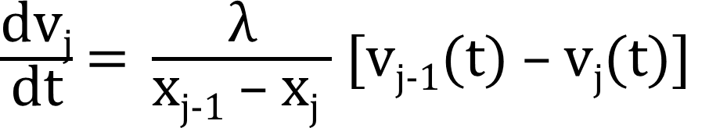
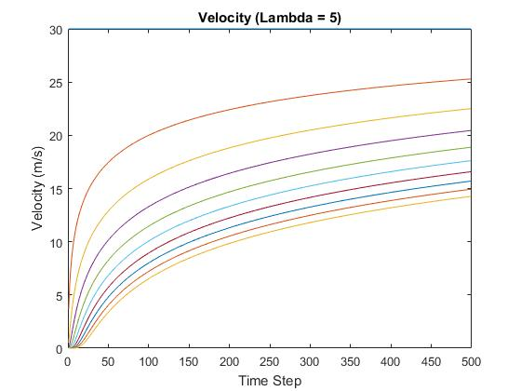
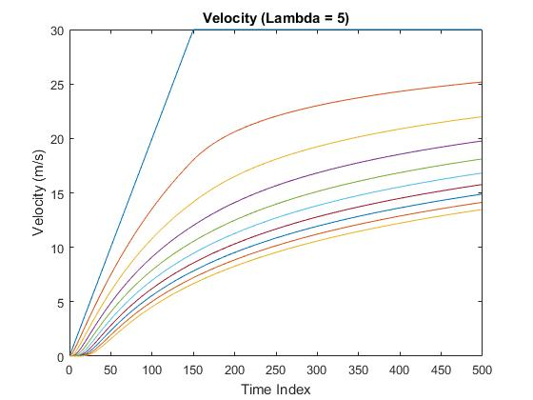
Velocity Comparison
Initial Velocity Defined
Constant Acceleration from Zero Velocity
λ = 5
d = 2
λ = 5
d = 2
Large distance between cars at first timestep, but also much larger velocity difference in initial steps.
Smaller distance between cars at first timestep, but also much smaller velocity difference in initial steps.
Notes:
Expected cars to be able to keep up better when acceleration was imposed

Slide 12

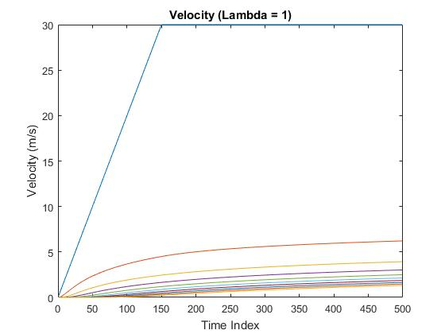
What Happens With A Smaller Lambda?
d = 2

Slide 13

Test Case 2: Sudden Stop

Slide 14
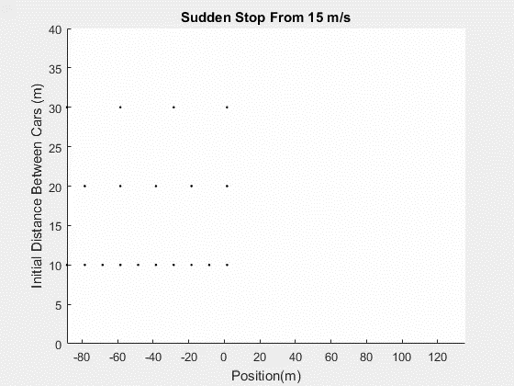
Trial 1
All cars are given an initial velocity, and the first slows to a sudden stop.
λ = 5
dt = .1
v = 15 m/s
Deceleration:
v[0] = v[0] – 10 m/s²
Notes:
Gave first car a deceleration equation. From 15 m/s – no crashes at any initial distances. OBSERVATION: Cars don’t start slowing down until very close to vehicle ahead of them.

Slide 15
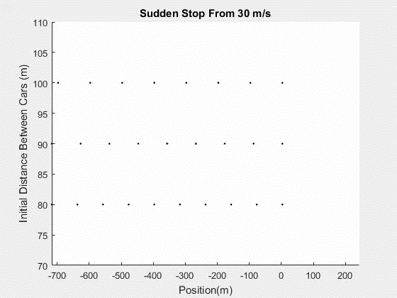
Trial 2: Greater Velocity
All cars are given an initial velocity, and the first slows to a sudden stop.
λ = 5
dt = .1
v = 30 m/s
Deceleration:
v[0] = v[0] – 10 m/s²
*Final stopping distance between cars is very small. In
reality, the cars probably would have crashed.
Notes:
When I change initial velocity of vehicles, takes much greater initial distance between cars to prevent a crash.

Slide 16
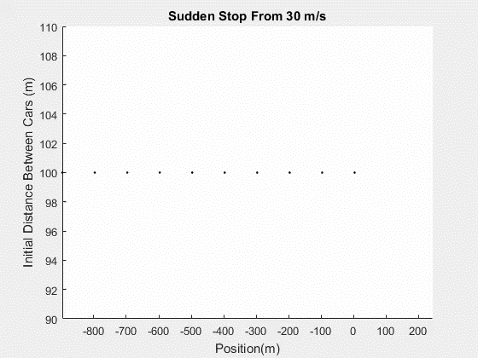
Trial 3: Greater Lambda
All cars are given an initial velocity, and the first slows to a sudden stop.
λ = 8
dt = .1
v = 30 m/s
Deceleration:
v[0] = v[0] – 5
For drivers to stop within safe distance of one another, lambda must be 8.
Notes:
Increase lambda to 8 to have reasonable resulting distances between vehicles.

Slide 17
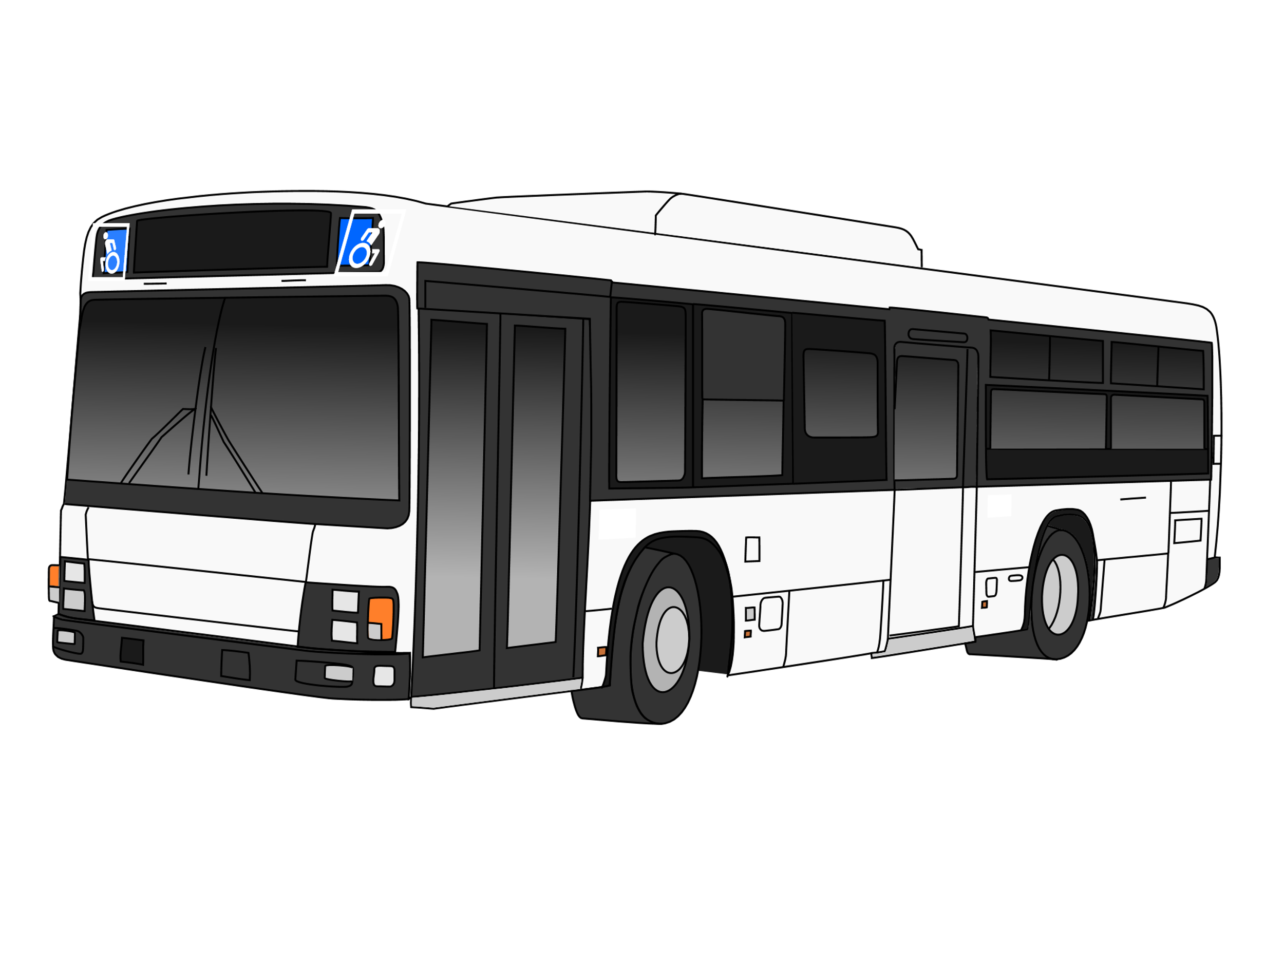
Test Case 3: Slow Lead Vehicle

Slide 18
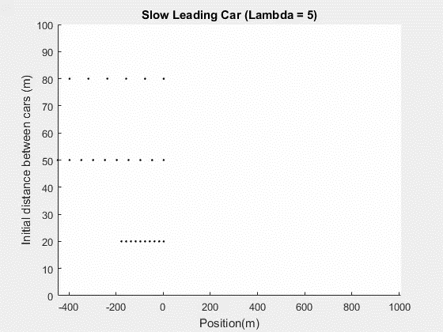
Trial 1
The initial velocity of the leading vehicle is slower than the initial velocities of the following vehicles.
λ = 5
dt = .1
v[1-9] = 30 m/s (~67 mph)
v[0] = 20 m/s (~45 mph)

Slide 19
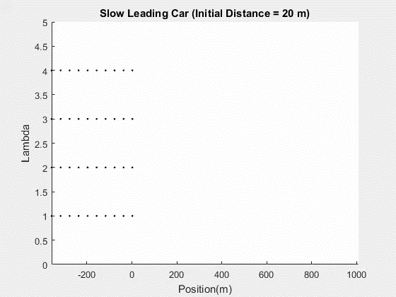
Trial 2: Various Lambdas
The initial velocity of the leading vehicle is slower than the initial velocities of the following vehicles.
λ varies
d = 20 m
dt = .1
v[1-9] = 30 m/s (~67 mph)
v[0] = 20 m/s (~45 mph)

Slide 20
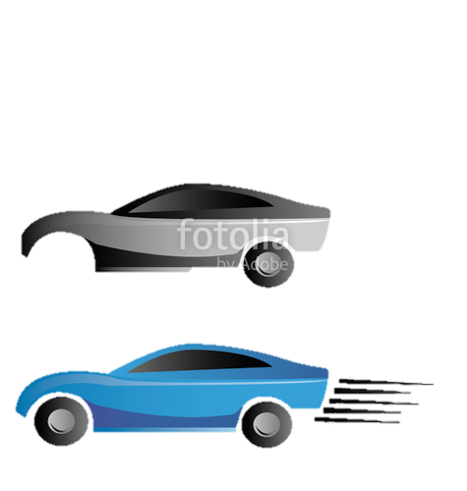
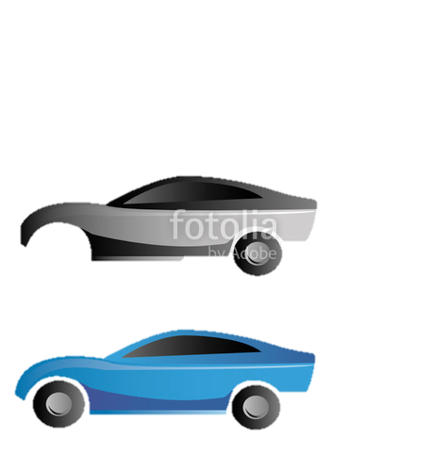
Test Case 4: Random Changes to Lead Vehicle Velocity
Notes:
No cruise control, driver may be distracted, etc.

Slide 21
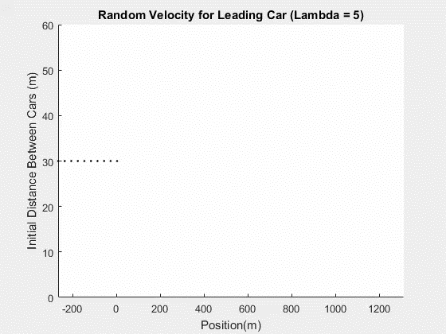
Trial 1
All cars are given the same initial velocity. Velocity of lead car changes randomly every 5 seconds.
λ = 5
dt = .1
d = 30 m
v = 25 m/s (~56 mph)

Slide 22
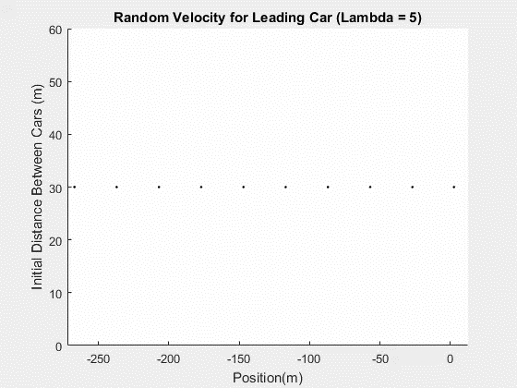
Trial 1
All cars are given the same initial velocity. Velocity of lead car changes randomly every 5 seconds.
λ = 5
dt = .1
d = 30 m
v = 25 m/s (~56 mph)
Notes:
Frame moves with vid

Slide 23

Trial 2: Smaller Lambda
All cars are given the same initial velocity. Velocity of lead car changes randomly every 5 seconds.
λ = 2
dt = .1
d = 30 m
v = 25 m/s (~56 mph)

Slide 24

Trial 2: Smaller Lambda
All cars are given the same initial velocity. Velocity of lead car changes randomly every 5 seconds.
λ = 2
dt = .1
d = 30 m
v = 25 m/s (~56 mph)
Notes:
Frame moves with video

Slide 25

Trial 3: Crash
All cars are given the same initial velocity. Velocity of lead car changes randomly every 5 seconds.
λ = 2
dt = .1
d = 30 m
v = 25 m/s (~56 mph)
Notes:
Conditions for crash were based upon if following vehicle’s position was greater than leading vehicle’s, but with small enough timestep will make vehicles decelerate very quickly so that position is tiny when they finish decelerating. Set to stop cars once dist. Between them is smaller than some small number.

Slide 26
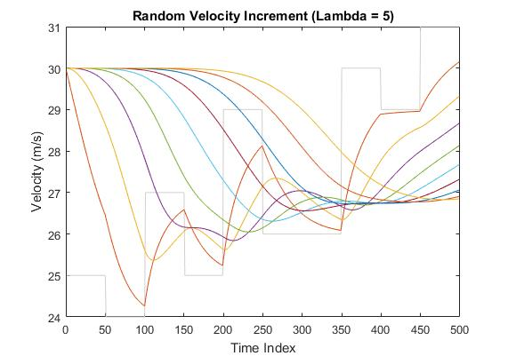
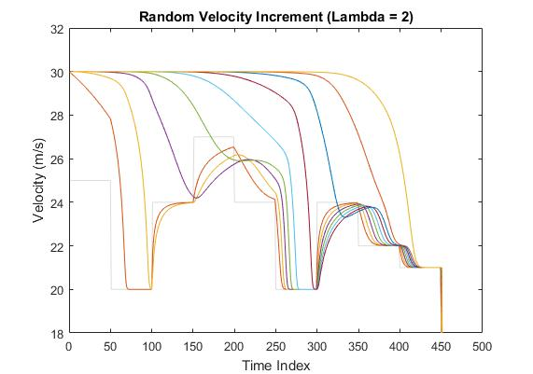
Velocity Comparison
Notes:
Explain which cars are which, etc.

Slide 27
Potential Improvements
Can make model more realistic by:
Making crash case more sensitive to distance between vehicles
Defining limit for driver reaction time
Defining limit for vehicle deceleration/acceleration
Assigning each driver a different lambda

Slide 28
Drive Safely! ☺

